Slide 1
MIPS PROCESSOR PROJECT Presented by: Mohamed Eslam Mohamed

Slide 2
MIPS processor implementation
Single-cycle that performs the tasks of instruction fetch, instruction decode, execution, memory access and write-back all in one clock cycle. First the PC value is used as an address to index the instruction memory which supplies a 32-bit value of the next instruction to be executed. This instruction is then divided into the different fields.
Pipeline processor in which instruction execution is divided into five stages as fetch, decode, execute, memory access and write back, denoted by IF, ID, EXE, MEM and WB. Execution of a program consists of a sequence of these steps. When the first instruction’s decode happens, the second instruction’s fetch is done. When the pipeline is filled, you see that there are five different activities taking place in parallel. All these activities are overlapped. all the information needed by the stages downstream must be passed along. Also implemented forwarding unit and hazard detection unit.

Slide 3
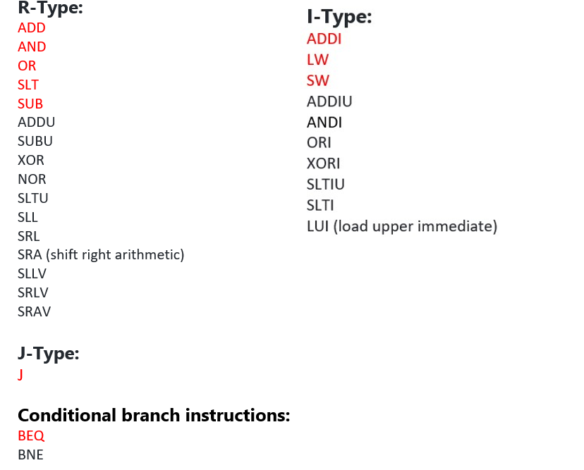
Supported instructions
Black colored instructions are additional bonus instructions

Slide 4
Instructions fetching
The “ROM” module fetches the instructions from a file called “memfile” which contains the machine code for the required instructions in hexadecimal assembly instructions with their machine code can be found in a file called “examples”.

Slide 5
Simulation
The simulation was done on Modelsim software, first compiles all the Verilog files,then executes the ‘’MIPS_tb’’ for SC or ‘’MIPS_PP_tb’’ for PP which runs the cpu in the given instruction set in ‘’memfile’’. For tracing read file ‘’how to trace’’.

Slide 6
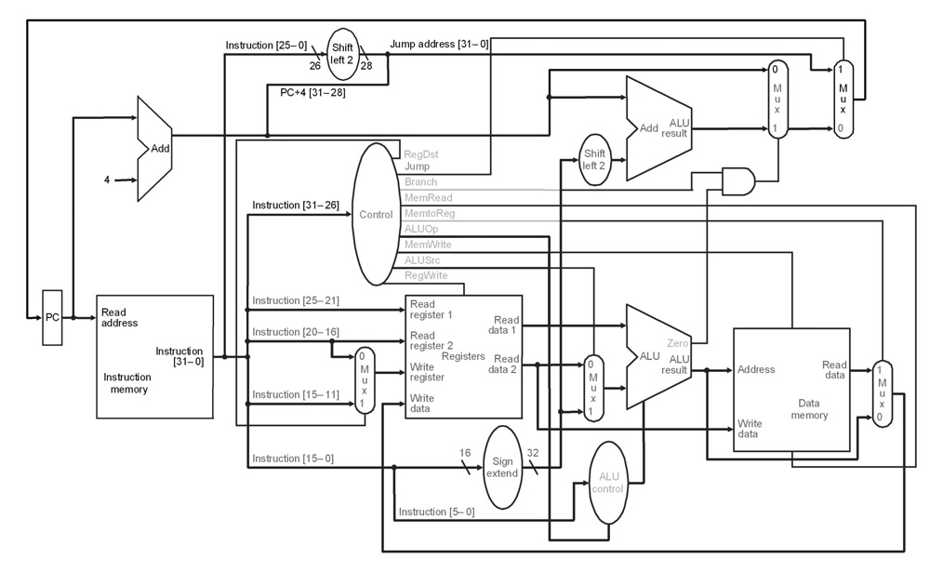
MIPS single cycle diagram

Slide 7
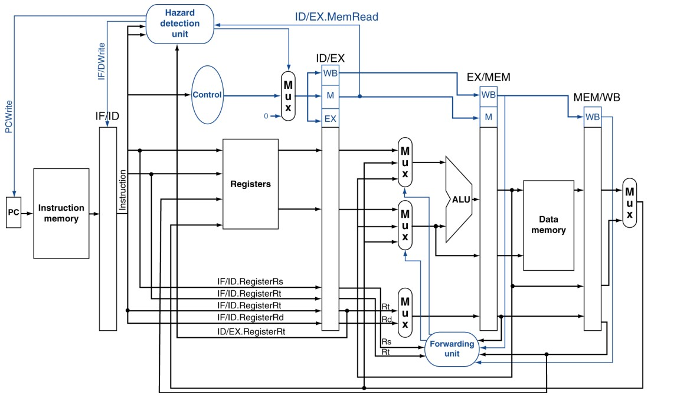
MIPS pipeline diagrams

Slide 8
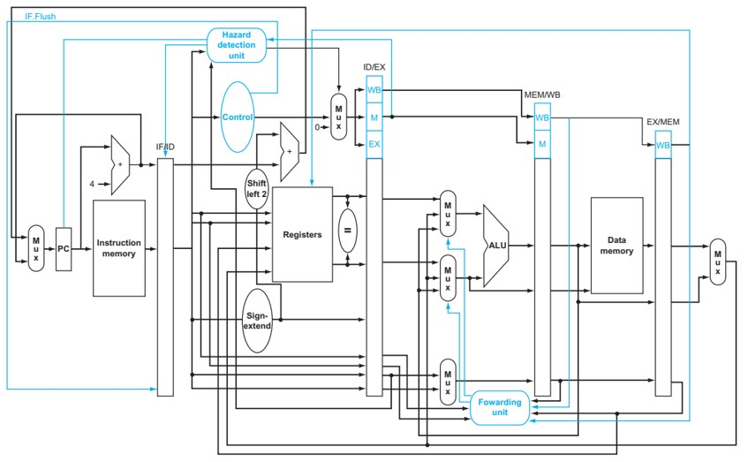

Slide 9
Test Results for single cycle
I tested all different types of instructions (R,I,J TYPE) and they all work and also tested different cases and special cases in code like looping ,skipping instructions and normal flow.
Verilog codes , examples and some instructions on how to run specific instructions and how to trace can found in the attached file

Slide 10
EX1: different R,I type instructions
addi $4,$0,27 //4 has 27 1bhex
xori $5,$4,5 //5 has 30 1ehex
add $6,$4,$5 //6 has 57 39hex
sub $7,$5,$4 //7 has 3 3hex
slt $8,$7,$6 //8 has 1 1hex
or $9,$7,$0 //9 has 3 3hex
and $10,$7,$0 //10 has 0 0hex
sll $11,$7,1 //11 has 6 6hex
srl $12,$7,1 //12 has 1 1hex
wr: write register
wd: write destinations

Slide 11
EX2: looping , bne , j
addi $5,$0,3
start: addi $6, $6,1
bne $5,$6,start
j 20 //jump to 14hex
wr:write register
wd:write destinations
y:output of jump mux
s:jump cntrl
d0,d1:inputs

Slide 12
EX3: not executing lines, beq , sw , lw
addi $5,$0,3 // 5 has 3
beq $0, $0, next // true
add $6, $5, $0 // never reached
next: sw $5,4($5) // sw from reg5 in memory stores 3
lw $7, 4($5) // lw from memory to reg 7 value 3
wr:write register
wd:write destinations
din:memory input
dout:memory output

Slide 13
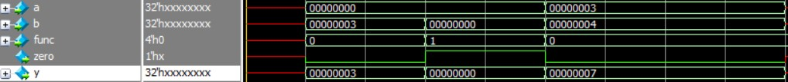
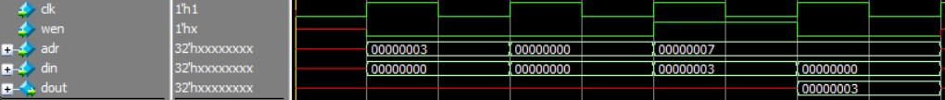
Test Results for single cycle blocks
addi $5,$0,3 // 5 has 3
beq $0, $0, next // true
add $6, $5, $0 // never reached
next: sw $5,4($5) // sw from reg5 in memory stores 3
lw $7, 4($5) // lw from memory to reg 7 value 3
Instruction memory simulation
Alu simulation
Registers File simulation
Data memory simulation

Slide 14
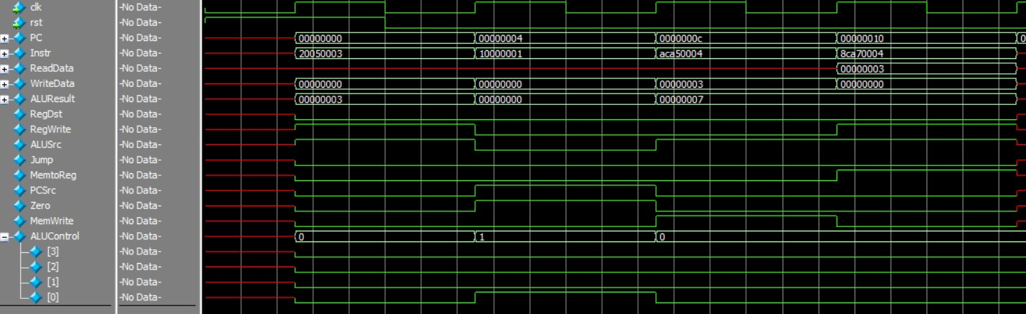
Single cycle processor full simulation

Slide 15
Bonus work pipeline implementation with hazard unit and forwarding unit

Slide 16
Test Results for pipeline blocks
addi $4,$0,27 //4 has 27
xori $5,$4,5 //5 has 30
lw $7, 4($5) // lw from memory to reg 7 load 34 Instruction memory simulation
Instruction memory simulation
Alu simulation
Registers File simulation
Data memory simulation

Slide 17
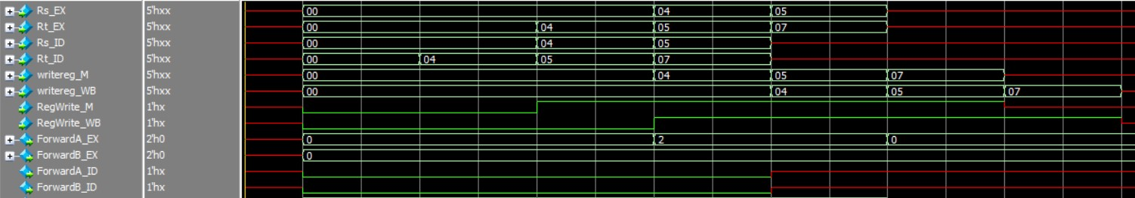
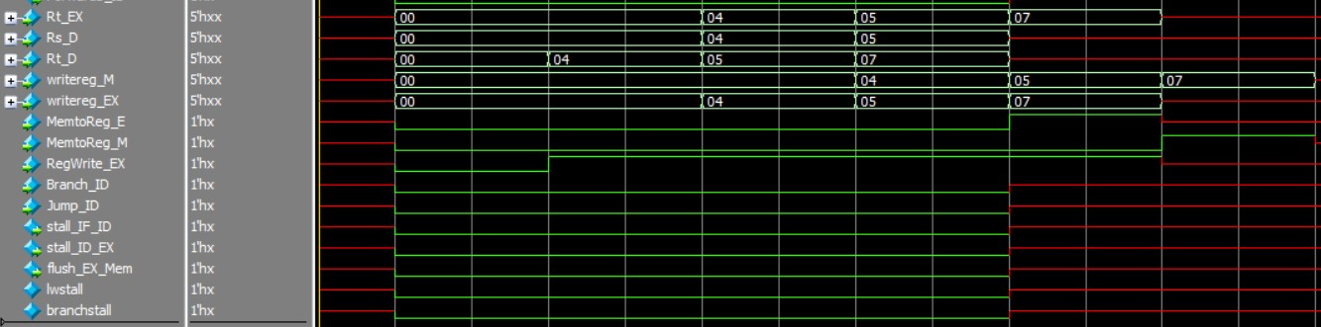
Forwarding unit
Hazard detection unit

Slide 18
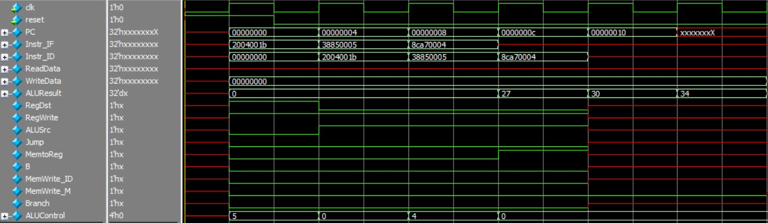
Pipeline processor full simulation
After 3 clock cycles there is an output at cycle 4 then outputs come consecutively as shown in “ALUResult”

Slide 19
References
“Computer Organization and Design” by John L Hennessy David
“Computer Organization and Design:The Hardware/Software Interface” by David A Patterson and John L Hennessy

Slide 20
THANK YOU

